Slide 1

Object Detection & Face Recognition: A Deep Dive
Welcome to this presentation on object detection and face recognition, two powerful applications of computer vision. We will explore the basics, techniques, and real-world applications of these technologies.
By RUDRA NARAYAN SAHU.

Slide 2
Introduction to Computer Vision
What is Computer Vision?
Key Applications
Computer vision is the field of Artificial Intelligence that enables computers to "see" and interpret images and videos like humans.
It powers a wide range of applications like self-driving cars, medical imaging analysis, and facial recognition systems.

Slide 3

Fundamentals of Object Detection & Face Recognition
1
Object Detection
2
Face Recognition
Identifying and locating objects within an image or video, assigning bounding boxes around them.
Identifying and verifying individuals based on their facial features.

Slide 4



Techniques & Algorithms
Convolutional Neural Networks (CNNs)
Deep Learning
Deep learning algorithms specifically designed for image processing and recognition tasks.
A powerful approach in AI using artificial neural networks to learn from large datasets.

Slide 5



Dataset Preparation & Preprocessing
Data Collection
1
Gathering a large and diverse set of images.
Data Annotation
2
Labeling objects and features in images for model training.
Data Augmentation
3
Creating variations of existing images to increase the dataset size.

Slide 6
Model Training & Optimization
Training
1
Feeding labeled data to the model for learning patterns.
Evaluation
2
Assessing the model's performance on unseen data.
Optimization
3
Fine-tuning the model's parameters to improve accuracy.

Slide 7
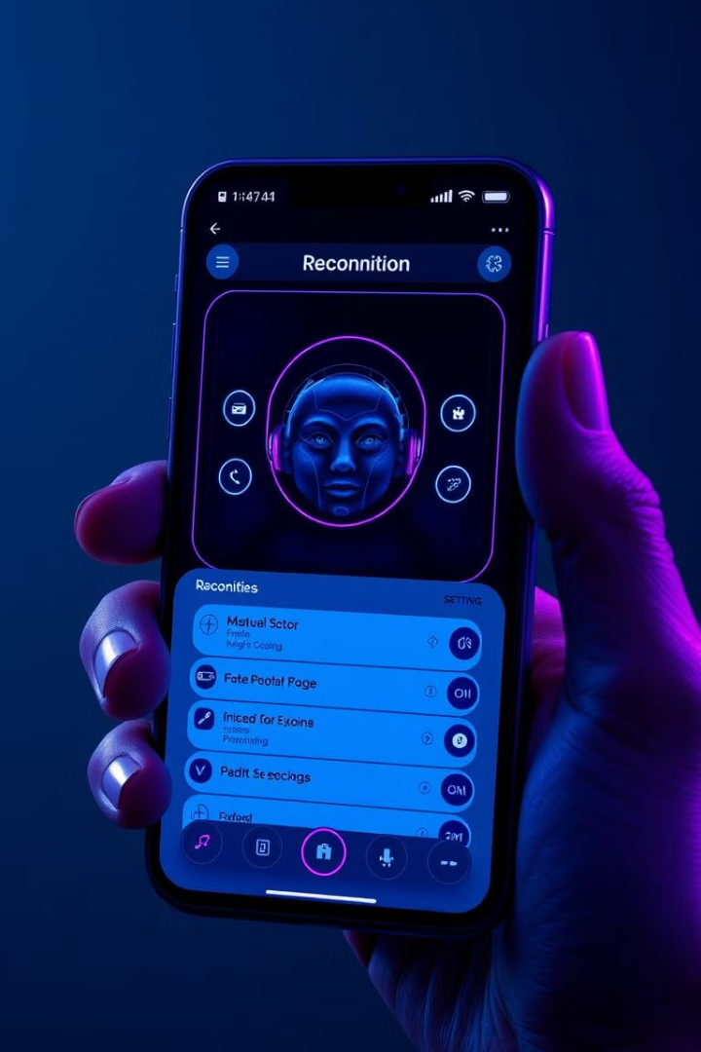
Deployment & Integration
1
2
Cloud
Edge Devices
Deploying models on cloud platforms for scalability.
Integrating models into smartphones and IoT devices.

Slide 8
Example with Code for Detection or Recognition
Python Implementation
OpenCV
TensorFlow
Object detection and face recognition models can be implemented using Python libraries like OpenCV, TensorFlow, and PyTorch.
OpenCV provides powerful tools for image processing, including object detection and face recognition.
TensorFlow is a machine learning framework used to develop and deploy deep learning models, including object detection and face recognition models.

Slide 9




Real-World Challenges
Privacy Concerns
Face recognition raises ethical questions regarding privacy and data security, especially in public spaces.
Bias and Fairness
Training data can reflect societal biases, leading to inaccurate or discriminatory results in face recognition systems.
Accuracy in Adverse Conditions
Variations in lighting, occlusion, and pose can significantly impact the accuracy of object detection and face recognition.
Real-Time Performance
Real-time applications require efficient processing and low latency for accurate and responsive object detection and face recognition.

Slide 10
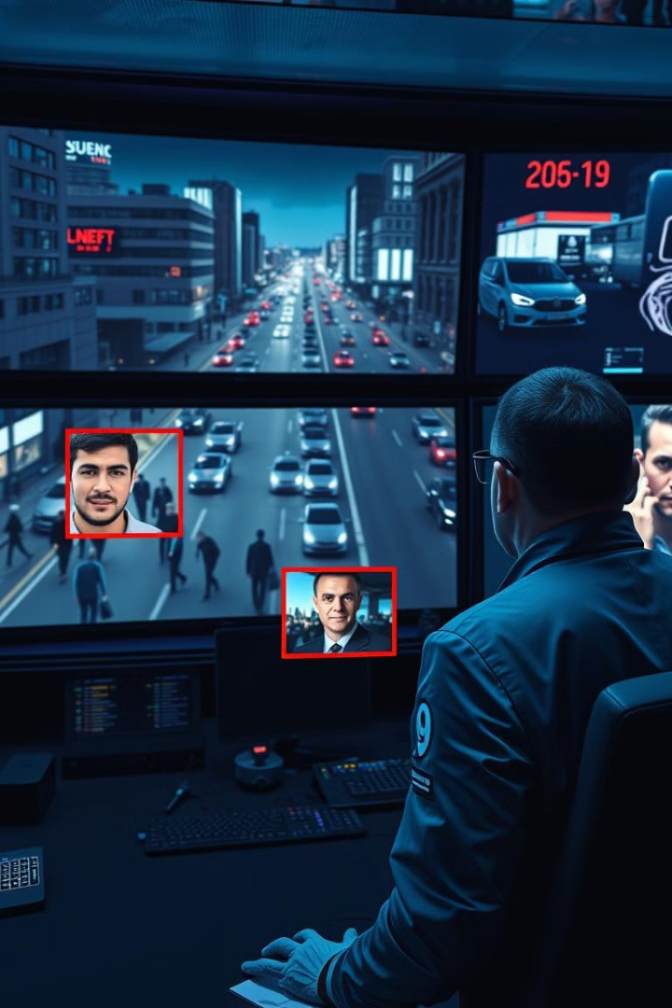
Application Examples
Object detection and face recognition have numerous applications across various industries.
From security systems to healthcare, these technologies are transforming how we interact with the world around us.

Slide 11
Ethical Considerations
Privacy Concerns
Bias and Fairness
Face recognition raises ethical questions about privacy and data security, particularly in public places.
Training data can reflect societal biases, potentially leading to inaccurate or discriminatory results.
The potential for misuse, such as unauthorized surveillance, is a significant concern.
It's crucial to ensure that face recognition systems are fair and do not perpetuate existing inequalities.

Slide 12
Hardware Requirements
Processing Power
Powerful CPUs and GPUs are necessary to handle the computationally intensive tasks of object detection and face recognition.
Memory Capacity
Large amounts of RAM are needed to store and process the substantial datasets involved in training and inference.
Storage Space
Significant storage space is required to store the models, datasets, and training logs.
Specialized Hardware
Dedicated hardware accelerators, such as TPUs or GPUs, can significantly enhance performance.

Slide 13
Bias in Data
1
Data Collection
Bias can creep in during data collection if the data is not representative of the population. For example, a dataset for facial recognition that primarily includes individuals of a particular race or ethnicity will lead to inaccurate or biased results for other races or ethnicities.
2
Data Labeling
The way data is labeled and annotated can also contribute to bias. For example, if a dataset for object detection is labeled with biased language, this can affect the performance of the model.
3
Model Training
When a model is trained on biased data, it can learn and perpetuate these biases, leading to unfair or discriminatory outcomes.

Slide 14

Conclusion & Future Directions
Object detection and face recognition have revolutionized various industries. Future advancements will focus on improving accuracy, efficiency, and real-time performance.

